Slide 1
Portfolio Task D Professional & Industrial Studies
Demonstration of Effective Interpersonal Skills
The Tacny Project
Vytautas Tumas
3rd December 2015
Notes:
Introduce yourself
Introduce todays topic

Slide 2

Program Verification
Notes:
Why program verification matters?

Slide 3
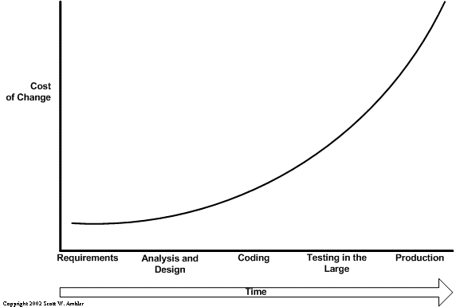
Program Verification
Economic Motives
Notes:
Worse still, omissions and defects introduced early within the
development life-cycle are the most expensive to rectify if they
go undetected until testing and beyond ..
Late life-cycle fixes are generally costly, i.e. can range from 40% to
100% more expensive than corrections in the early phases

Slide 4
Program Verification
Safety Motive
Therac 25 Computer-controlled radiation therapy machine. Due to a software bug patients were given a massive overdose of radiation.
Ariane 5 Flight 501 An overflow condition crashed both primary and backup computers, causing the $8 billion rocket to initiate the self-destruct sequence.
Notes:
used in US and Canadian hospitals during the 1980's.
The accidents occurred when the high-power electron beam was activated instead of the intended low power beam, and without the beam spreader plate rotated into place. Previous models had hardware interlocks in place to prevent this, but Therac-25 had removed them, depending instead on software interlocks for safety. The software interlock could fail due to a race condition. The defect was as follows: a one-byte counter in a testing routine frequently overflowed; if an operator provided manual input to the machine at the precise moment that this counter overflowed, the interlock would fail
The greater horizontal acceleration caused a data conversion from a 64-bit floating point number to a 16-bit signed integer value to overflow and cause a hardware exception. Efficiency considerations had omitted range checks for this particular variable, though conversions of other variables in the code were protected. The exception halted the reference platforms, resulting in the destruction of the flight.

Slide 5

The Tacny Project

Slide 6
The Tacny Project
The project:
Show that it is possible to abstract proof guidance by encoding them in tactics
Targeted at Dafny
Me:
Hired as Research Assistant at Heriot-Watt University
Design and implement the Tacny tool prototype
Notes:
Focusing on the Dafny programming language and a program verifier, the tacny project aims to develop a notion of tactic for Dafny so that common proof patterns can be reused.

Slide 7
Dafny
Programming language and program verifier
Specify program properties with contracts (pre/post conditions)
Guide the proof with specialised annotation

Slide 8
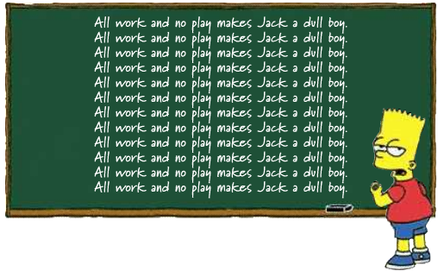
Dafny Observation
Program proofs follow a very similar pattern
But each proof has to be guided manually

Slide 9
The Tacny Project
What the tool does:
Introduces a set of atom statements to write generic proof guidance
Reduces development time by allowing to reuse verification patterns
Improves code readability
Simplifies the program verification process.

Slide 10
The Tacny Project Requirements
Familiar
The Tacny tool must be familiar to Dafny users
The Tacny tool reuses existing Dafny syntax

Slide 11
The Tacny Project Requirements
Correct
Correctness: neither program nor specification should change
Employs a small kernel of trusted rules and their compositions

Slide 12
The Tacny Project Requirements
Checkable
Proofs generated by Tacny must be checkable
Tacny generates Dafny proofs that are checkable by the verifier

Slide 13
The Tacny Project Requirements
Reduce Overhead
Tactics should reduce annotation overhead
A single tactic can be reused for multiple proofs

Slide 14
The Tacny Project Outcome
Success
Successfully implemented the tool
Submitted a paper to the TACAS conference
But…
Tacny is slow
Requires a lot of memory to run

Slide 15
Thank you for listening
Questions?

